Slide 1



BIOMEDICAL ENGINEERING • THIRD YEAR PROJECT
Embedded Respiratory Pattern
Monitoring and Early
Warning System
A smart, portable embedded system that continuously tracks breathing patterns and raises instant alerts for early clinical intervention.
Presented by: DHIVYA RANJANI P, RAMYA M Department: Biomedical Engineering College: VSB ENGINEERING COLLEGE ,KARUR

Slide 2





Introduction
PROJECT OVERVIEW
What is Respiratory Monitoring?
Why Continuous Monitoring?
Continuous tracking of breathing rate, depth and rhythm to detect abnormal respiratory patterns in real time.
Respiratory diseases like asthma, COPD and sleep apnea can worsen suddenly, making constant tracking essential for safety.
Role of Embedded Systems
Why Early Warning Matters
Compact microcontrollers enable low-cost, low-power, real-time biomedical devices outside traditional hospital settings.
Instant alerts to doctors or caregivers allow timely intervention, preventing emergencies before they escalate.
ERPM-EWS | BIOMEDICAL ENGINEERING
02 / 12

Slide 3

Abstract
PROJECT SUMMARY
Objective
System Flow
Design a compact, wearable embedded system that continuously senses respiration and flags abnormal patterns before they become critical.
Patient
Respiratory Sensor
Working Principle
A respiratory sensor captures chest movement signals, which an embedded controller digitizes, filters and analyzes against trained breathing-pattern thresholds in real time.
Embedded Controller
(ESP32 / Arduino)
Signal Processing
Expected Outcome
Respiratory Pattern
Analysis
A portable, affordable monitor that delivers instant visual, audible and wireless alerts to caregivers — enabling faster clinical response than conventional monitors.
Early Warning Alert
Doctor / Caregiver
ERPM-EWS | BIOMEDICAL ENGINEERING
03 / 12

Slide 4
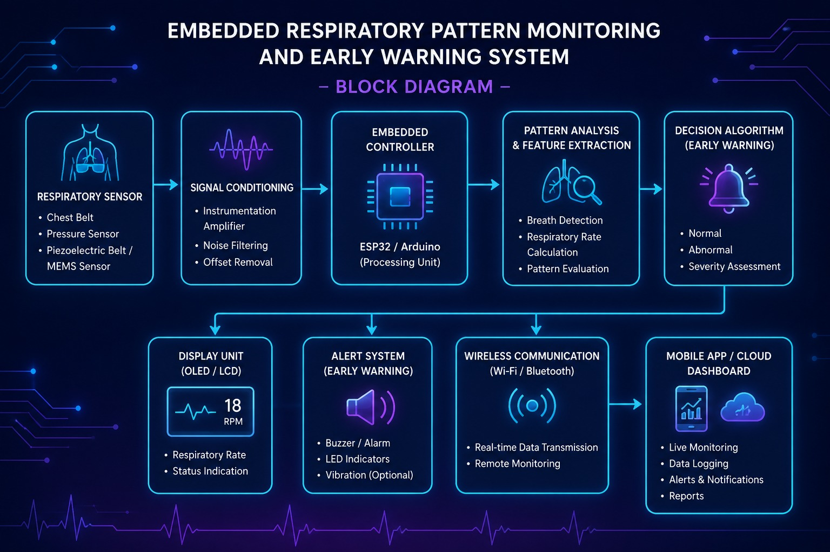

Slide 5



Problem Statement
WHY THIS PROJECT
Increasing Respiratory Diseases
Expensive Monitoring Equipment
Lack of Portable Monitoring
Delayed Emergency Detection
Need for Affordable Embedded Systems
Rising asthma, COPD and sleep-related disorders demand scalable monitoring.
ICU-grade monitors are costly, limiting access for most patients.
Existing devices are bulky and confined to hospital settings.
Manual observation leads to slow response during sudden distress.
A low-cost, real-time solution is essential for wider healthcare reach.
ERPM-EWS | BIOMEDICAL ENGINEERING
04 / 12

Slide 6


Existing Model
CURRENT CLINICAL APPROACH
Today, respiratory monitoring relies on ICU respiratory monitors, ventilator monitoring systems and pulse oximeters — all operated within hospital infrastructure.
Existing System — Block Diagram
Patient
ICU Respiratory Monitors
Respiratory Sensor
Bedside units tracking rate and rhythm continuously.
Signal Conditioning
Ventilator Monitoring Systems
Hospital Monitor
Integrated with life-support machines in critical care.
Medical Staff
Pulse Oximeters
Clip-on sensors estimating oxygen saturation and pulse.
Signals are captured at the bedside, conditioned, and displayed on hospital monitors for continuous manual review by medical staff.
ERPM-EWS | BIOMEDICAL ENGINEERING
05 / 12

Slide 7




Drawbacks of Existing Systems
LIMITATIONS
High Cost
Large Equipment
Hospital Dependent
Not Portable
High Maintenance
Delayed Emergency Alert
No Remote Monitoring
ERPM-EWS | BIOMEDICAL ENGINEERING
06 / 12

Slide 8

How We Overcome the Drawbacks
EXISTING vs PROPOSED
EXISTING SYSTEM
PROPOSED EMBEDDED SYSTEM
Expensive
Low Cost
Hospital Only
Home + Hospital
Manual Monitoring
Automatic Monitoring
No Remote Access
Wireless Monitoring
Delayed Alert
Instant Alert
Bulky Device
Portable Device
ERPM-EWS | BIOMEDICAL ENGINEERING
07 / 12

Slide 9


Proposed System
EMBEDDED ARCHITECTURE
Patient
Respiratory Sensor
Signal Conditioning
1
2
3
ESP32 / Arduino Nano
Respiratory Pattern
Detection Algorithm
LCD Display
4
5
6
Buzzer
Wi-Fi / Bluetooth
Doctor Mobile Application
7
8
9
ERPM-EWS | BIOMEDICAL ENGINEERING
08 / 12

Slide 10






Where We Are Using
DEPLOYMENT SETTINGS
Hospitals
ICU
Ambulance
Home Healthcare
Rural Healthcare
Rehabilitation Centers
Elderly Care
Sleep Monitoring
ERPM-EWS | BIOMEDICAL ENGINEERING
09 / 12

Slide 11


Who Is Beneficial
STAKEHOLDERS
Asthma Patients
COPD Patients
Elderly People
Infants
Sleep Apnea Patients
Post-operative Patients
Doctors
Nurses
Caregivers
ERPM-EWS | BIOMEDICAL ENGINEERING
10 / 12

Slide 12


Advantages & Applications
IMPACT
Advantages
Applications
Low Cost
Smart Hospitals
Portable
Telemedicine
Lightweight
IoT Healthcare
Accurate
Wearable Medical Devices
Continuous Monitoring
Emergency Medical Services
Real-Time Alert
Home Healthcare
Low Power Consumption
Easy to Use
Military Healthcare
Early Warning System
Remote Patient Monitoring
ERPM-EWS | BIOMEDICAL ENGINEERING
11 / 12

Slide 13

THANK YOU
Embedded Respiratory Pattern Monitoring and Early Warning System
Questions & Discussion Welcome

